Slide 1
IPEN Adolescent Presentations
Oct 30th
Sydney 2012

Slide 2

Welcome
Welcome (Jim)
Executive committee (Erica)
  Jim Sallis & Coordinating Center investigators (Marc Adams, Jacqueline Kerr, Terry Conway)
  Erica Hinckson
  Jo Salmon
  Ilse De Bourdeaudhuij
  Rodrigo Reis
  Ester Cerin

Slide 3
Executive Committee
Jim Sallis
Jo Salmon
Ilse De Bourdeaudhuij
Rodrigo Reis
Ester Cerin
Erica Hinckson
who are you?
where are you from?
what do you do?
what do you like to do at the weekend?
anything else?
IPEN-A

Slide 4
Funding update (Jim)
Funds are here
Not all countries are funded
  Primary/secondary/exploratory countries
We will continue to support you to get funding
Restrictions on subcontracts till State Dept review
  Terrorist status
  Approved IRB board (i.e., FWA approvals)
Expected timeline
  Trying to disperse data collection funding in first 2 years
  Worse case scenario…subcontracts took 8-10 months in IPEN Adult

Slide 5
Country Updates – 5 mins each
Australia
Belgium
Brazil
Malaysia
Denmark
Czech Republic
Portugal
Taiwan
New Zealand
Hong Kong
USA
Japan
Spain
Bangladesh
Nigeria

Slide 6
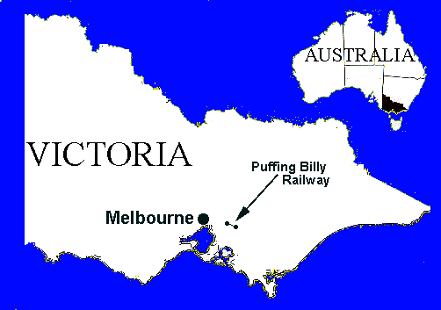

Slide 7
IPEN Adolescent update - Australia
  Funding
    Initial plan for n=350, applying for funding to support larger study with value-adds: increased sample to 1200, addition of food env, addition of GPS, addition of pilot active transport/healthy eating intervention
    Currently tooling up to pilot GPS units with Year 7 and 9 students (ethics pending) with internal funds
  Staffing: Deakin University, Melbourne
    Prof Jo Salmon & Dr Anna Timperio, Co-CIs
    Prof Ester Cerin, Dr Jenny Veitch, Dr Lukar Thornton, Dr Alison Carver, Dr Sarah McNaughton, Dr Kylie Ball, Dr Shannon Sahlqvist
  Staffing: Uni of Melbourne
    Prof Billie Giles-Corti, Dr Hanna Badland, Suzanne Mavoa

Slide 8
IPEN Adolescent update - Australia
  Training needs –not needed
    Accelerometer (Deakin)
    GIS (Uni Melb)
  Materials preparation – not needed
    Survey translation
  GIS & Neighborhood selection
    Neighbourhoods selected last year based on walkability score (hi/low SEP; hi/low walkability quadrants identified)
  Participant recruitment & data collection
    Participants to be recruited through schools, targeting Year 7 and 9 students (13 & 15 yrs)
    GT3X+, GPS, activPAL, survey (self-report, proxy-report)

Slide 9
IPEN Adolescent -Belgium
Funding
  Data collection has been completed with funding of Ghent University
Staffing
  Femke De Meester has done data collection and processed the Belgian data
  Delfien Van Dyck coordinates for IPEN adolescent
Training needs
  No training needs for accelerometer or GIS
Materials preparation
  No official translation available yet for adolescent questionnaire
  Official translation available for adult NEWS

Slide 10
IPEN Adolescent -Belgium
GIS & Neighborhood selection
  32 neighborhoods selected in Ghent
  Same neighborhoods as adult study (+8)
  Neighborhood selection: statistical sectors
    Walkability: GIS-based info on residential density, land use mix, street connectivity
    Income: neighborhood-level mean annual income data
  Individual level GIS information available: same parameters as IPEN adult
    Probably additional GIS variables needed for IPEN adolescent

Slide 11
IPEN Adolescent -Belgium
Participant recruitment & data collection
  Data collection completed in 637 adolescents across quadrants
  Collected data:
    Accelerometer 7-day
    FPAQ (interview)
    NEWS (self-report)
    Psychosocial questionnaire (self-report)
    Sociodemographic factors (self-report)

Slide 12
IPEN Adolescent – Brazil update
Funding:
  Awaiting applications result
    GPS acquisition - Nov 1
    Policy Dissemination – Nov?
    NIH grant IRB approved but pending on national IRB approval
Staffing:
  Students
    3 PhD + 4 MSc students (up to 7?)
    GIS (Adriano Akira), ESRI support, Acc (Priscilla)
Training Needs:
  Accelerometer – No training needed
  GIS – No training needed
  GOS –Yes (pending on grant’s results)
    GPS acquisition - Nov 1
    Policy Dissemination – Nov?

Slide 13
IPEN Adolescent – Brazil update
Material preparation:
  ANEWS-Y and Psychosocial measures
    ANEWS-Y back translated and adapted
    Test-retest reliability study (823 adolescents, 115 parents October 1 – 22)
    No additional measures need to be tested
  Audits
    School audit (ISCOLE)
    Parks & Plaza (PARA)
    Street audit (TBD)

Slide 14
IPEN Adolescent – Brazil update
GIS & Neighborhood selection
  Walkability and Income
    Residential density, Street density (> 3 segments), Land use (5 categories), Commercial density
    Updating database
  Census tracts selection and auditing
    Dec-Jan 2012
  Participant recruitment & data collection
    Participants recruitment Feb 2012 (Private company)
    Data collection March-June
    All pending on funding

Slide 15
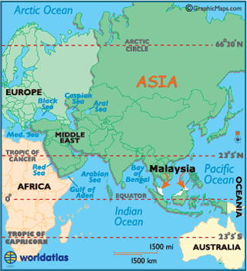
IPEN Malaysia Update

Slide 16
IPEN Adolescent - Malaysia
A developing country in South-East Asia
Multi-ethnic
  60% Malay, 24% Chinese, 7% Indian
70% urban
Bahasa Malaysia primary language, although English widely spoken
Sport/physical activity perceived to be beneficial:
  Individual – health & wellbeing
  Social – promoting social interaction & racial harmony, community health & reducing juvenile delinquency
  National – focus for national pride & enhancement of national image internationally
Low levels of pop. physical activity

Slide 17
IPEN Adolescent - Malaysia
Institutions
  Lead - Institut Sukan Negara (National Institute of Sport)
  Collaborator Monash University
Researchers
  Dr Noela Wilson PI ISN
  Dr Jenny Oxley PI – Monash
  Mohd Zaid Bin Mohd Ghazali Research Assoc. ISN
Malaysia IPEN Sydney 2012

Slide 18
IPEN Adolescent - Malaysia
Funding
  Initial application declined
  A further application to be made in November, 2012
FWA status
  Application made
Ethical Approval
  To be made in November to ISN & Monash
Staffing
  Two new appointments have been made
  Further research assistants will be required.
Malaysia IPEN Sydney 2012

Slide 19
IPEN Adolescent - Malaysia
Training needs
  Accelerometers. An inhouse study underway to familiarise staff with accelerometers & data interpretation
  GIS. More training will be required
Materials preparation
  Decision on parent questionnaire to be finalised
  Adolescent questionnaires prepared in English
  Funding for survey translation declined in August, to be included in Nov application
GIS & Neighborhood selection
  No final decisions made
Participant recruitment & data collection
  No final decisions made
Malaysia IPEN Sydney 2012

Slide 20
IPEN Adolescent - Denmark
Investigators please report on status of:
  Fund
    Awaiting feedback from NIH (Dec 2012) as starting point for national fundraising for additional costs
  Staffing
    Lars Breum Christiansen – postdoc/assistant professor
    Jasper Schipperijn - associate professor
    PhD student (?)
  Training needs
    No need of training with the current staff
  Materials preparation
    Survey translation
      Translation and back translation of the particular IPEN questions intended for adolescents

Slide 21
IPEN Adolescent - Denmark
  GIS & Neighborhood selection
    Use the walkability index at school district level and selecting 4 schools with different walkability characteristics and socio-economic status
    The walkability index is based on: residential density, network density, FAR-ratio and land use mix)
    Cooperation with municipality of Aarhus (same as in IPEN adult)
  Participant recruitment & data collection
    Recruitment will be through the schools
    Expected sample size: 400 at the age range 12-16
    All wearing accelerometers
    Expected response rate up to 80%

Slide 22
Denmark written report
The Danish study will include students from at least four schools in Aarhus with different built environment and socioeconomic characteristics to assure the most variety in the sample. The selection of the schools will copy the IPEN adult study-protocol, except that the statistical districts will be replaced with school districts. There are 66 eligible school districts in Aarhus. On each school at least 100 students will be recruited to participate in the study. They will attend 5th to 9th grade being at the age range 12-16.
Both subjective and objective measures will be used in the study. A questionnaire consisting of the Danish version of the NEWS-Y and additional questions regarding school commuting, recreational activities, physical education, health behavior and psychosocial factors will be completed by the students in school hours. We have good experience with response rate in the school setting and expect it to very high in this study as well (70-90 %).
The objective measure of physical activity will be measured with accelerometers (ActiGraph GT3X) with an epoch length at 5 seconds. The participants will be instructed to wear it for seven days and in all waken hours. To ensure compliance the accelerometers will be delivered to the respondents at school where they will receive thorough information on the accelerometer use and additionally they will on consent receive daily reminding text-messages on their mobile phone.
The built environment will be objectively assessed with Geographical Information System (GIS). The Danish GIS system is well-developed and we have detailed and precise information on many built environment factors (e.g. roads, footpaths, green areas, land use and recreational facilities).

Slide 23
IPEN Adolescent – Czech Republic
Investigators please report on status of:
  Funding
    Supported by the Faculty of Physical Culture with internal grant programs and from submitted grant money (we do not know the acceptance yet, but the funding will be even without the governmental grants)
    Covered

Slide 24
IPEN Adolescent – Czech Republic
Investigators please report on status of:
  Staffing
    Josef Mitáš
    Karel Frömel
    Jan Dygrýn
    František Chmelík
    Jana Vašíčková

Slide 25
IPEN Adolescent – Czech Republic
Investigators please report on status of:
  Training needs
    Accelerometer – not needed
    GIS – not needed

Slide 26
IPEN Adolescent – Czech Republic
Investigators please report on status of:
  Materials preparation
    Survey translation – use of the ANEWS-youth
    Czech translation is done, first evaluation at schools is processed
    Accelerometers logs ready (+ we have about 700 accelerometers)
    GIS data ready due to same location (Olomouc and Hradec Kralove)
    Possible use of ANEWS in internet system INDARES.com

Slide 27
IPEN Adolescent – Czech Republic
Investigators please report on status of:
  GIS & Neighborhood selection
    GIS based on IPEN adults – data ready
    Neighborhood selection will be made based on the buffer of schools – students then will report their physical activity in home neighborhood
    School environments as other outcome will be observed in this study

Slide 28
IPEN Adolescent – Czech Republic
Investigators please report on status of:
  Participant recruitment & data collection
    Students and pupils from schools in Olomouc and Hradec Kralove meeting the age criteria
    Starting the data collection in spring 2013 and repeating in fall 2013
    We expect to have 400 adolescents monitored in both Olomouc and Hradec Kralove

Slide 29
IPEN Adolescent – Czech Republic
Research grant from ministry is over (succesful evaluation)
Support from the research money from ministry allows continue in the same range
New post-doc positions (one will be oriented at the IPEN-youths grant) and Ph.D. student involved in this topic
Ready for data collection (accelerometers, surveys, supporting materials, staff)
Poor in writing papers ☺

Slide 30
IPEN Adolescent - Portugal
Investigators please report on status of:
  Funding
  Staffing - 4 persons
Andreia – Acelerometer and GPS data collection and analises
Rose and Paula – SIG and questionnaires
Tânia – data colection
  Training needs
    Accelerometer: √ ; wear time validation; Meterplus;
    GIS: variables used and information gathering is difficult/payed
  Materials preparation
    Survey translation: awaiting feedback and new questions remaining
Notes:
Em relação as necessidades de formação para acelerometros já não são necessárias pois estou já a par e já sei o que aplicar, mas como não se decidiu os minutos de zeros consecutivos a questão da wear time validation pode variar eles querem 7 dias completos.
Coloquei meterplus, pois é a forma que utilizam para fazer um screening dos dados, para ver se não há falhas ou erros não detectaveis pelo actilife. Para ter esse programa é nec uma licença; a Kelli mostrou-me rapidamente os procedimentos de screning neste programa.
GIS: pelo que sei acho que seria bom haver uma reuniao com uma apresentaçao/ webinar dos protocolos a fazer, temos duvidas em algumas variáveis e como as conseguir mas já falei com o Marc e na próxima semana em principio vamos falar via skype. Arranjar alguma informação será difícil uma vez que não esta disponivel gratuitamente.
Em relação aos materiais a primeira versao do questionario foi traduzida e a Kelli ficou de me enviar os comentários/feedback à tradução para ver se é necessária alteração; mas agora usam uma versão mais recente e temos que traduzir as questões adicionais.

Slide 31
IPEN Adolescent - Portugal
  GIS & Neighborhood selection:
  schools from High and Low SES recruited both in high and low walkability areas
  Participant recruitment & data collection: all students will be invited and parent written consent will be needed - 300 students from public schools in Porto area; data collection to begin in November /December
Notes:
As áreas da cidade do Porto incluem diferentes estratos Socio económicos e estão distribuídas de forma semelhante entre baixa e alta walkability.
Participantes terão de ser 300 e vamos começar a recolher no próximo mês já (somos os primeiros!!!!! tirando usa que já tem os dados) a Kelli disse para não se preocupar com a data pois a maioria não vai começar já (nos vamos para aproveitar as recolhas do phd da rose).

Slide 32
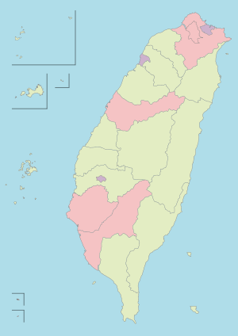
IPEN Adolescent - Taiwan
Investigators please report on status of:
  Staffing:
    Han-Lin Chen: Associate Professor in Geographical Science
    Yi-Liang Kuo: Assistant Professor in Physical Therapy
    Chia-Feng, Maple, Yen: Assistant Professor in Public Health
    Chi-Fen Zeng, Lecturer in Nursing
    Hui-Ling Liu, research assistant
  Funding: obtained funding from National Science Council for one year
Notes:
Red words: we (LL) added

Slide 33
Country Updates – Taiwan
Aims – first year 2012.08.01-2013.07.31
  Systematic review
    A systematic review of the association between the built environment and physical activity in Taiwanese adolescents
  Pilot test of the procedure
    Survey translation and validation
      Survey translation
      Back translation
      Discussion in group
      Discussion in panel
    GIS
    Accelerometer
  Seeking funding for following years
IPEN Sydney 2012

Slide 34
Adolescent country update - Taiwan
Investigators please report on status of:
  Materials preparation
    Survey translation: we are discussing a translated questionnaire and will test its validity and reliability this year.
  GIS & Neighborhood selection
    School districts in Hualien County
  Participant recruitment & data collection
    pilot test the survey via school district
    Sample size: 300
IPEN Sydney 2012

Slide 35
Adolescent country update - Taiwan
Training needs: we need training for the following two. We got some experiences in using accelerometer and GIS but limited.
    Accelerometer
    GIS
IPEN Sydney 2012

Slide 36
IPEN Adolescent– New Zealand update
Funding
  Received funding from Health Research Council of New Zealand (1.2 mil). The budget is very tight and may need assistance with additional accelerometers. We budgeted for 100 but to complete the study within 3 years we may need another 100 (~27k USD). Ethics approval has been received.
Staffing
  Erica Hinckson (Co-PI), Grant Schofield (CO-PI), Ester Cerin (Co-I), Suzanne Mavoa (Co-I), Scott Duncan (Co-I), Melody Oliver (Co-I), Hannah Badland (CO-I), Vivienne Ivory (Co-I) Kate White (Research Officer), Julia McPhee (Research Manager) plus two fieldworkers and PG student.

Slide 37
Country Updates – New Zealand
Training needs
  We have previously worked with Actical accelerometers, we are now switching to GT3X+: yes
  GIS-IPEN adult: may be
GIS Neighbourhood selection
  Student addresses
  Determine individual walkability
  Select lowest and highest walkable neighbourhoods
  Participant recruitment & data collection
  Large schools in Auckland and Wellington (n=1600)
  Accelerometer, GPS, VERITAS, ANEWS-Y, focus groups

Slide 38

Coordination Center (Jim)
Roles (cc Kelli on all correspondence)
  Kelli Cain: accelerometers, NIH reporting, main point of contact
  Carrie Geremia: website, recruitment monitoring
  Alex Mignano: survey translations & code book
  Brooks Lecomte: invoicing, admin
  Kavita Gavand: survey data cleaning
  Marc Adams: GIS
Resources
  Accelerometer loan
  Training
  Materials
  Databases for tracking & data entry
  Website

Slide 39
Coordination Center (Jim)
Communication
  Regular check ins (twice a year at least)
    Especially during neighborhood selection and data collection
  Memorandum of Understanding
  Represent your country on website
    Follow example template provided
Meeting planning
  ISBNPA Ghent 2013 (May)
  ISBNPA 2014 San Diego (May/June),
  ICPAH Rio 2014 (April)

Slide 40

Orientation to study & lessons learned

Slide 41
Timeline
Countries will have unique timelines but here is the
general plan:
Yrs 1-2: Study preparation and data collection
Yr 3: Data transfer and processing
Yr 4: Analysis and papers

Slide 42
Study sequence flowchart
1. Prepare
2. Collect
3. Manage
Obtain GIS data
Neighborhood selection
Survey translations/approvals
Accelerometers & training
Years 1-2 funding
Recruitment & monitoring
Survey checking
Accelerometer compliance screening
Years 1-2 funding
File & variable names
Survey cleaning
GIS templates
CC comparability assessments
Years 2-3 funding
4. Process
5. Papers
6. Policy!
GIS buffers (countries)
Surveys (CC)
Accelerometers (CC)
Years 2-3 funding
Select topics
Proposals for review with Publications Committee
Analysis
Manuscripts
Year 4 funding
Communicate results to local, national & international policy makers
Create summary briefs
Start making contacts
Year 4+ funding

Slide 43
Overall expectations
“Requirements” needed for quality control
Budgeting for things you didn’t think of:
  Software
  Quality control
  GIS
  Stats
  Travel
Follow protocols especially for variable naming and coding

Slide 44
Neighborhood selection
Walkability x Income (2 x 2) design
Lesson learned
  Countries may need to include additional variables to reflect their environment e.g. slopes
  Some countries couldn’t get household income from Census
    May be other sources e.g. house prices
  Bring to life with photos
Resources
  See website
    www.ipenproject.org/methods
  Walkability paper (Frank 2010)
  IPEN Adult templates
    Adolescent neighborhood selection version coming

Slide 45
Neighborhood selection cont.
Preparations/training
  Find contacts to get the data
  Speak with local experts on neighborhoods
Requirements
  Need to provide CC with selection process & rankings
  We can brainstorm solutions to missing data etc.
Discussion
  What about sites recruiting around schools?
    Sample a greater number of schools with fewer students
    Select schools in different quadrants

Slide 46
Survey
Issues
Lots of cleaning by CC
Wide deviations from recommended surveys
  Created survey guidelines
    Wording, response options, missing items, variable names
  Back translation checks
IPAQ ‘follow-up’ protocols varied
Resources
Will develop checklist for data cleaning
Clear survey recommendations with variable naming, coding & skip patterns
Entry templates
  Access, SPSS

Slide 47
Survey cont.
Requirements
Approval of back translation with CC
  allow time for review, modifications and re-review
Follow variable names & coding
Follow up with participants for missing items
Discussion
Parent survey – STRONGLY RECOMMENDED for comparability

Slide 48

Accelerometer data collection
Issues
Despite training & manuals countries deviated in meaningful ways
  CC will process all data in standard way
Dates not recorded when participants wearing or devices delivered/retrieved
Resources
Accelerometers
Tracking database
Training manual
Check in with Kelli

Slide 49
Accelerometer issues in kids
Model
Low frequency filter
Non wear time
Epoch
Cut points
Wear time days and hours
  Instructions to participants
  Processing decisions
    Number days, hours.
    Weekends
Compliance strategies
  Rewears
  Reminders
  Logs
  Incentives
  Time Filters
    In school vs out of school time
It’s complicated!
IPEN developing recommendations

Slide 50
Accelerometer data collection cont.
Requirements
Certify staff in compliance screening procedures
CC to do quality control check on first 50 participants
Give participants 7 full wear days
  E.g. pick up on 9th day
Logs
  Participant completed
  Research delivery & pick up days and times
  School start and end times for in-school/out-of-school filtering
Prompting calls/texts for wear
Compliance checking for rewear
  Screening in Meterplus
Tips
Name files correctly when downloading

Slide 51
Recruitment
Balance recruitment across
  Quadrants
  Seasons
  Gender
Age range (12 – 18 years old)
  Be careful if recruiting by grades
Regular recruitment reports to CC to check above
  Template for reports will be provided by CC
Training in presenting study to participants
  Accelerometer expectations
  Not focus on “exercise”
  Incentives
  Parent/child involvement

Slide 52
Data Processing & transfer
Code books
Comparability assessment
Participant IDs and Accel. File naming
  Country code part of participant ID
  Consistent across accelerometer, survey, GIS
Master ID file
  Quadrant/block group/city details
  Participants with complete data

Slide 53

Survey
Do not send personal identifying information
  ID codes only
  -- no names, addresses, etc.
All sites to clean data (CC will provide guidelines)

Slide 54
Accelerometer Processing
CC will process all data for pooling
File naming
  Participant ID, GIS, survey all must match ACC file name
    Country code first
Documentation
  Tracking database
    Logs dates in database
Electronic transfer

Slide 55
GIS buffers (Arc GIS)
Issues
Data not available
  Desired, preferred, required variable e.g. land use
  Recommended & acceptable procedures
  Sub country analyses
Creating correct buffer from start is key
  Check with Marc
Is time consuming work
Requirements
Complete template, filling out questions
  See website (http://www.ipenproject.org/methods_gis)
  p4 Section 1 outlines details above
Name variables correctly before sending
Participant IDs same as survey and accelerometer

Slide 56
GIS buffers (Arc GIS)
Additional opportunities??
Pedestrian network
Bike facilities
Preparations/training
Hiring the right GIS staff (planning depts), test skills on template
Visit CC with your data
Ask Marc at CC
Discussion
Multiple buffers 500m, 1000m, 2000m?? Used all 3 in TEAN

Slide 57
BREAK!!

Slide 58
Statistical needs: Modeling approach (Ester)
Proposed statistical methods and modeling approaches
  Generalized additive mixed regression models (random intercepts)
  “Common” modeling approach

Slide 59
Statistical needs: Modeling approach
(1) Generalized additive mixed regression models (random intercepts)
  Multiple regression methods (multiple predictors)
  Mixed models (multilevel models) to account for multiple levels of clustering (variation)
  Generalized models to model non-normally distributed outcomes
  Additive models to explore the shape of the relationships between explanatory variables and outcomes
Notes:
Random intercepts rather than coefficients as our main aim is to account for clustering at the neighborhood level. We are not interested in variations in coefficients across neighborhoods within site (in this paper).

Slide 60
Statistical needs: Modeling approach
(2) “Common” modeling approach
  Identify redundant covariates; exclude them from models
  Examine associations of single environmental attributes with outcomes (adjusted for study site and socio-demographic covariates)
    Explore various variance (Gaussian, Gamma and inverse binomial) and link functions (logarithmic or identity)
    Main effects and two-way and three-way interaction effects (gender and site)
  Examine independent association of multiple environmental attributes with outcomes
    Use best fitting variance and link functions from single-predictor models
    Include significant main and interaction effects (from previous models)
  Construct composite indices of neighborhood walkability and PA friendliness based on multiple-predictor models (OPTIONAL)
    Use best fitting variance and link functions from single-predictor models
    Main effects and two-way and three-way interaction effects (gender and site)
Notes:
Random intercepts rather than coefficients as our main aim is to account for clustering at the neighborhood level. We are not interested in variations in coefficients across neighborhoods within site (in this paper).

Slide 61
Statistical needs: Multiple imputation models
Create 20 imputed datasets if more than 5% of cases have missing values on at least one variable
Why?
  Most data are missing at random (MAR): the probability that an observation is missing commonly depends on information that is available in the dataset, i.e., the reason for missingness is based on other observed participant’s characteristics.
    In this case, participants with complete data are a biased sub-sample of all participants. A complete case analysis would usually produce biased results. In addition, there is loss of power due to analyzing a smaller dataset.
  All simple techniques of handling missing data (complete case analysis, the indicator method and overall mean imputation) give biased results.
  Multiple imputations are a more appropriate alternative because they produce good estimates of variability in the dataset and yield unbiased estimates if missing data are MAR.

Slide 62
Describe dose-response relationships (shape of association)
Statistically
Variables | exp(b) | exp (95% CI) | p
Models with single environmental attributes
Main effects
Residential density | 0.994 | 0.964, 1.025 | .704
Land use mix diversity – proximity of destinations (linear) | 0.932 | 0.877, 0.991 | .024
Land use mix diversity – proximity of destinations (curvilinear smooth)* | F(1.72)=8.01 |  | <.001
Land use mix diversity – # destinations within 20min walk | 0.788 | 0.655, 0.948 | .012
Land use mix diversity – # destinations within 20min walk (curvilinear smooth)* | F(3.91)=5.22 |  | <.001

Slide 63
Describe dose-response relationships (shape of association)
Visually

Slide 64
Who can do the analyses?
Multi-stage sampling procedures + non-normally distributed data -> complex analyses
Generalized linear mixed models
Generalized additive mixed models for exploring complex dose-response relationships.
Analysts should possess very good knowledge of these statistical procedures.
Missing data ->multiple imputations for multilevel models
Candidate analysts -> statisticians should have a tertiary degree in statistics
Demonstrable knowledge in the above procedures, in the form of published work or unpublished technical reports or dissertations/theses for which they conducted or supervised the analyses
Potential sources of candidates are statistical and public health departments of local universities, and governmental census and statistical departments.

Slide 65

Paper writing & authorship (Ilse)
Publication committee
Publication guidelines
Proposal process

Slide 66
Guiding Principles of IPEN Publications
To fulfil the Specific Aims of the IPEN study
To maximize the scientific impact of IPEN by encouraging publication of many high-quality papers
To contribute evidence to policy discussions in national and international governments and organizations
To provide opportunities for investigators in every participating country to be lead author on a paper

Slide 67
General issues
Vancouver-rules
Publication Committee monitors
Publication proposals are needed
Use of as many countries as possible: pooled analyses
One author from each IPEN country shall be included on manuscripts in which that country’s data are included.

Slide 68
Manuscript Assignment Procedure
List of potential manuscripts provided and open for other ideas
Researchers can choose manuscripts they want to lead (1st, 2nd, 3rd choice)
Publication committee allocates papers

Slide 69
Proposal Procedure
Lead author assembles a group of potential authors and a small writing group
Lead author submits paper proposal
Proposals discussed and approved by Publication Committee
Circulation of early draft, active participation of all co-authors
Monitoring of whole process by Publication Committee

Slide 70
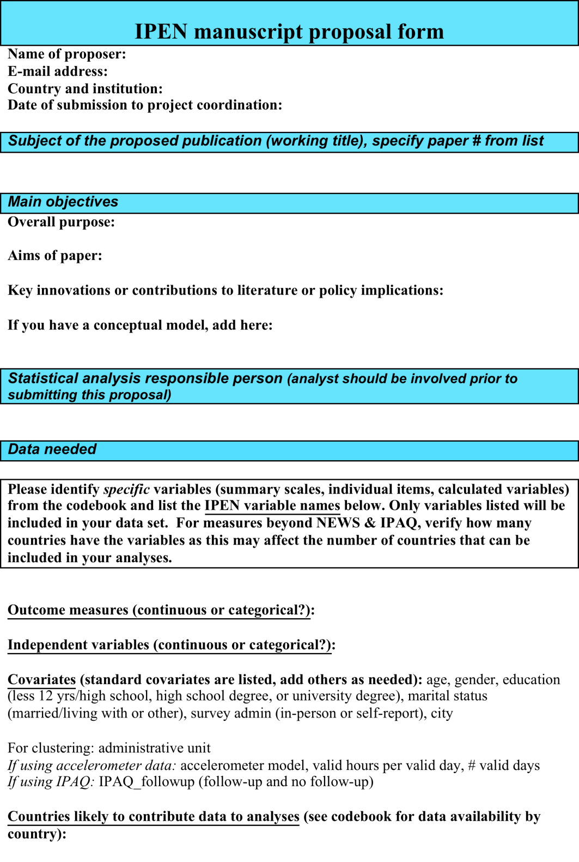

Slide 71


Slide 72
Presentation
Symposia / Oral / Poster / Invited
Abstract sent to project coordinator and co-authors
Information on time and location
Approval after 7 days

Slide 73
Website
Status of manuscripts can be followed up through the website
PDF of manuscript on the website if permitted
Abstracts on the website
Also non-English abstracts on the website
Acknowledgement of IPEN NIH Grant

Slide 74
Pooled analyses / country specific
For pooled analyses
Many high quality papers!
Every researcher gets his/her chance
International papers
For country specific analyses in 1 country
Each lead investigator owns the data for that country.
Investigators have transferred data to the IPEN Adult Coordinating Center for pooled analyses, and each country contributing data will be involved in analyses and papers.
Investigators in each country can use their own data for any purposes whatsoever

Slide 75
IPEN-Y Policy Dissemination (Rodrigo)
Pros
  Systematic approach for disseminating
  Optimize resources and expertise
  Increase awareness on built environment and PA
  Influence decisions in the decision making process
Cons
  Lack of expertise within the team
  Funding was planned to attend this need
  Nearly impossible standardized “contextual factors”

Slide 76
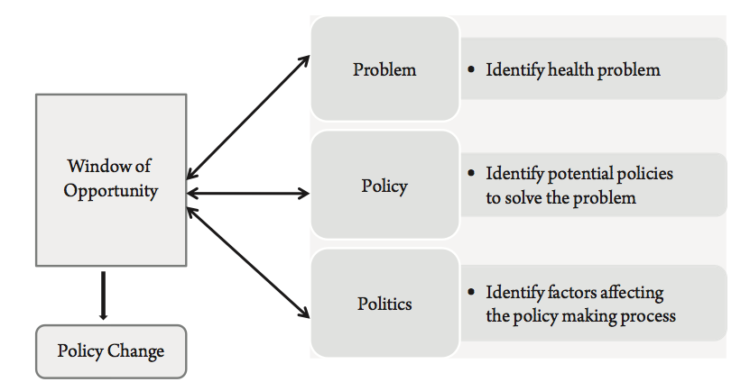
Policy Process

Slide 77
IPEN-Y Policy Dissemination
Problem
  Physical inactivity
  Other health outcomes are more “attractive”
Policy(ies) and Politics
  Clear message (guided by results)
  Local, National and International policies (layers of complexity)
Window of opportunity
  Define level of influence

Slide 78
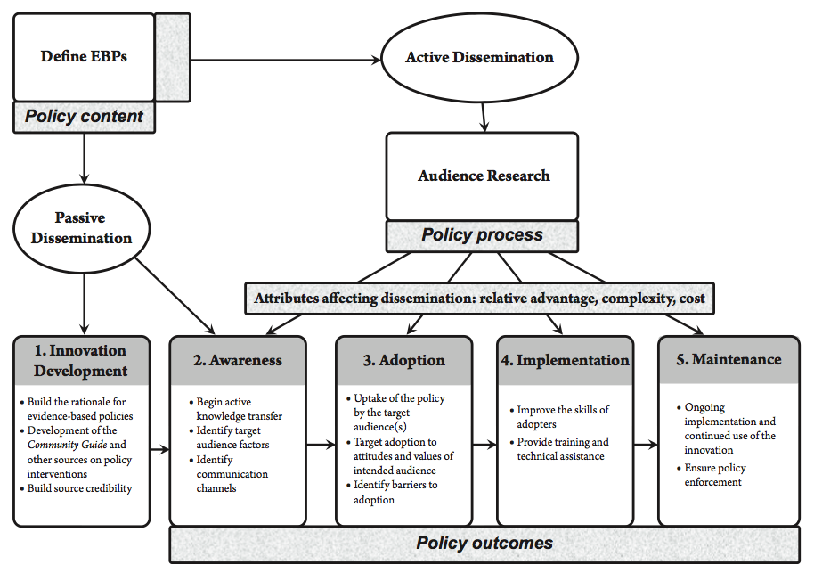
Dissemination of Evidence-Based Policy

Slide 79
IPEN-Y Policy Dissemination
Tools
  Briefs
  Testimonies
Define and targeting the audience
  Local, National and International Level
  Clear message (guided by results)
  Find a “champion” for the massage
Funding
  Non-profit organizations

Slide 80
Lesson learned from IPEN Adult
Investigators visited CC
Brazil
  Managing field workers
Denmark
  Working with municipality
Hong Kong
  Alternative recruitment methods
Photos of neighborhoods
Others??

Slide 81
Other opportunities???
Cultural issues
Economic evaluations
Street audits
GPS

Slide 82
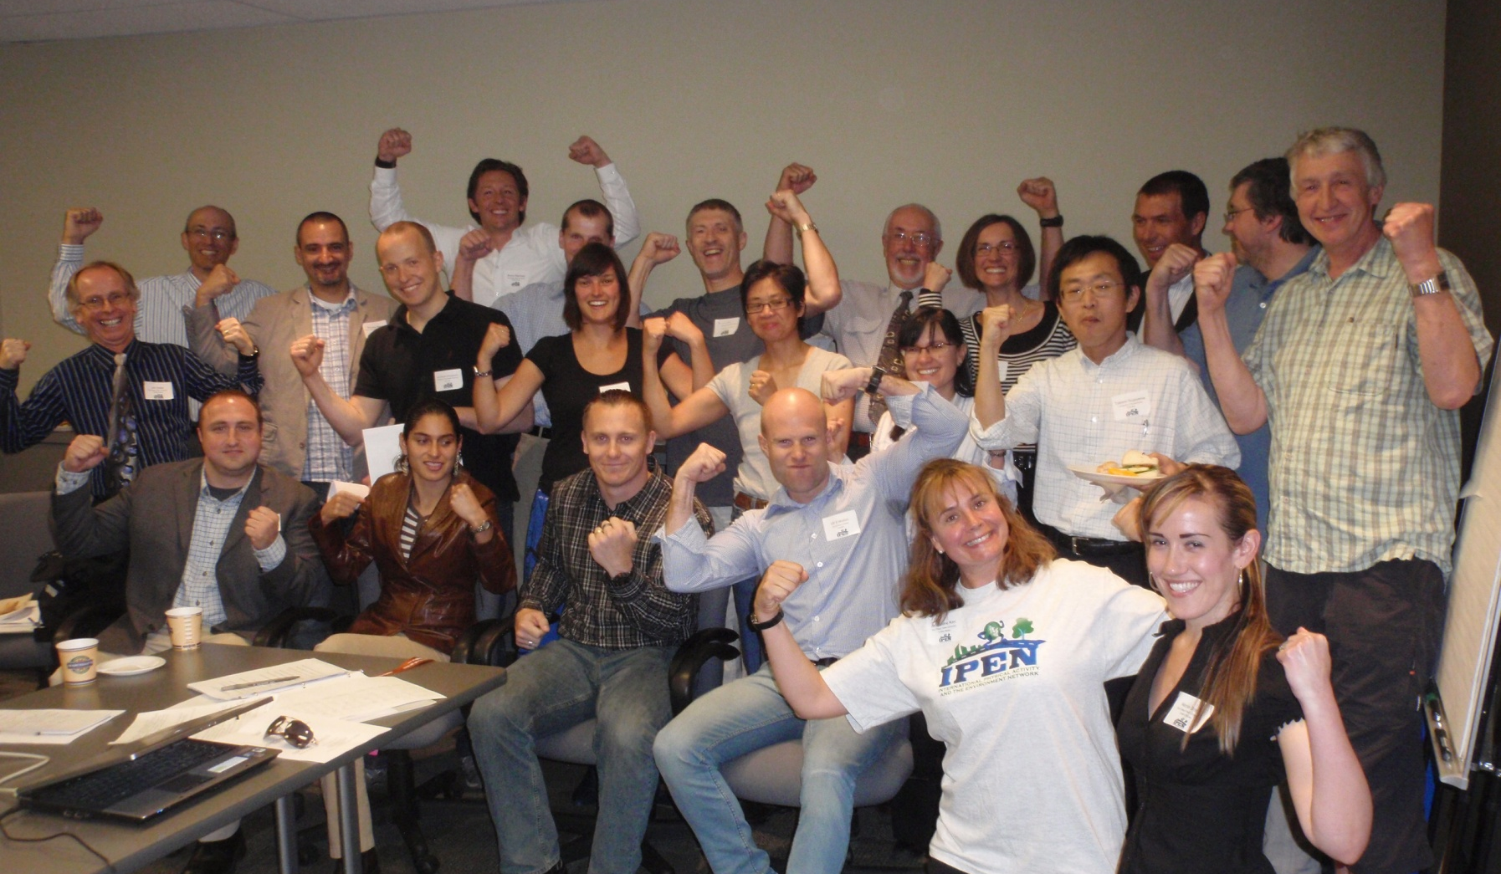
Questions?

Slide 83
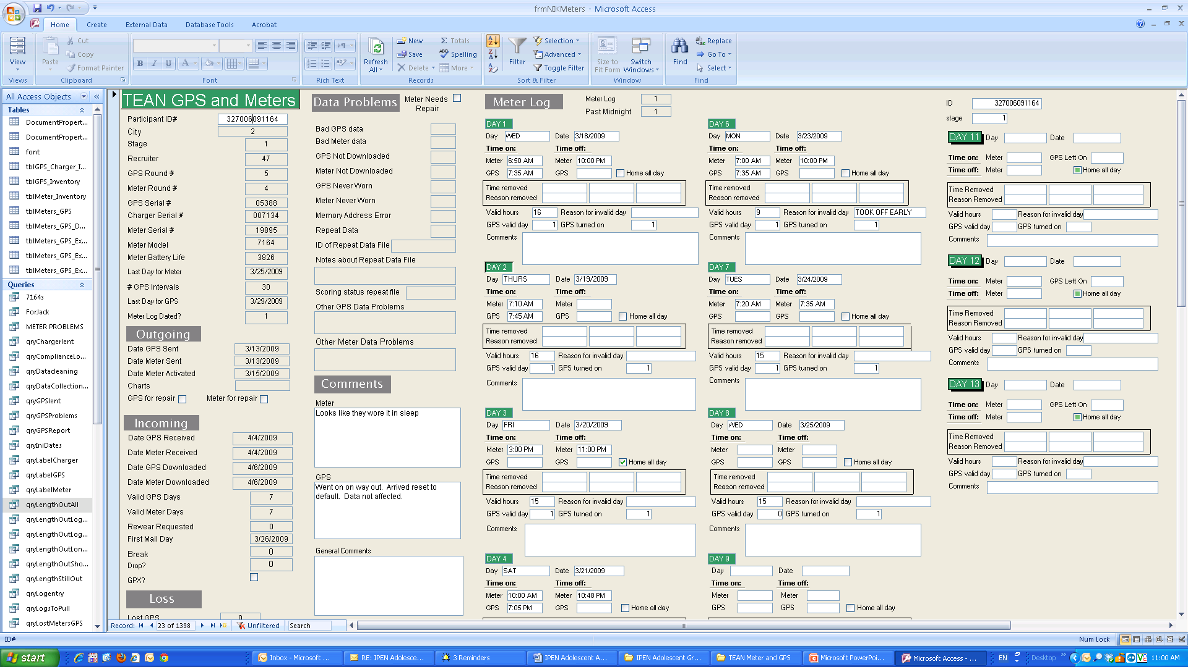
Example Tracking Database

Slide 84
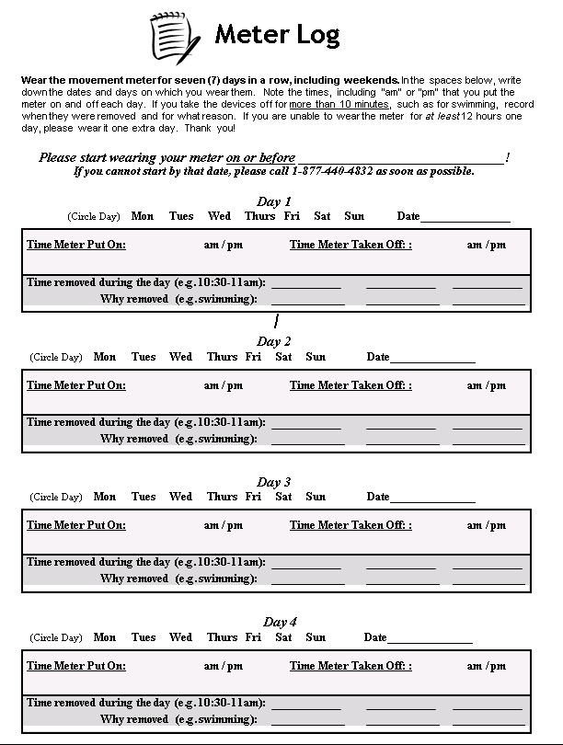
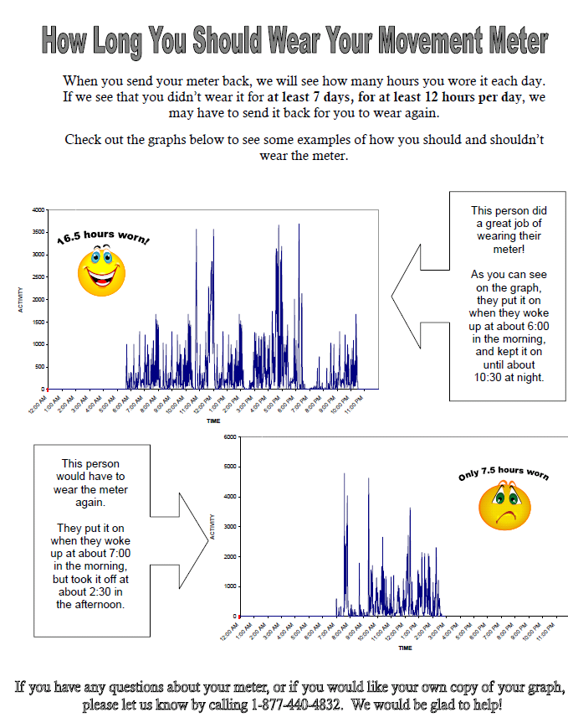
Wear log & Instruction examples

